Slide 1
Inventory Management
Drashti Soni (200502122)
Vishva Shah (200495565)
Premal Patel (200499806)
August 1st, 2024
Software Testing and Validation (ENSE 375)

Slide 2
Agenda
Introduction
Problem Definition
Design Requirements
Solutions
Testing and Demonstration
Project Management
Conclusion and Future Scope

Slide 3
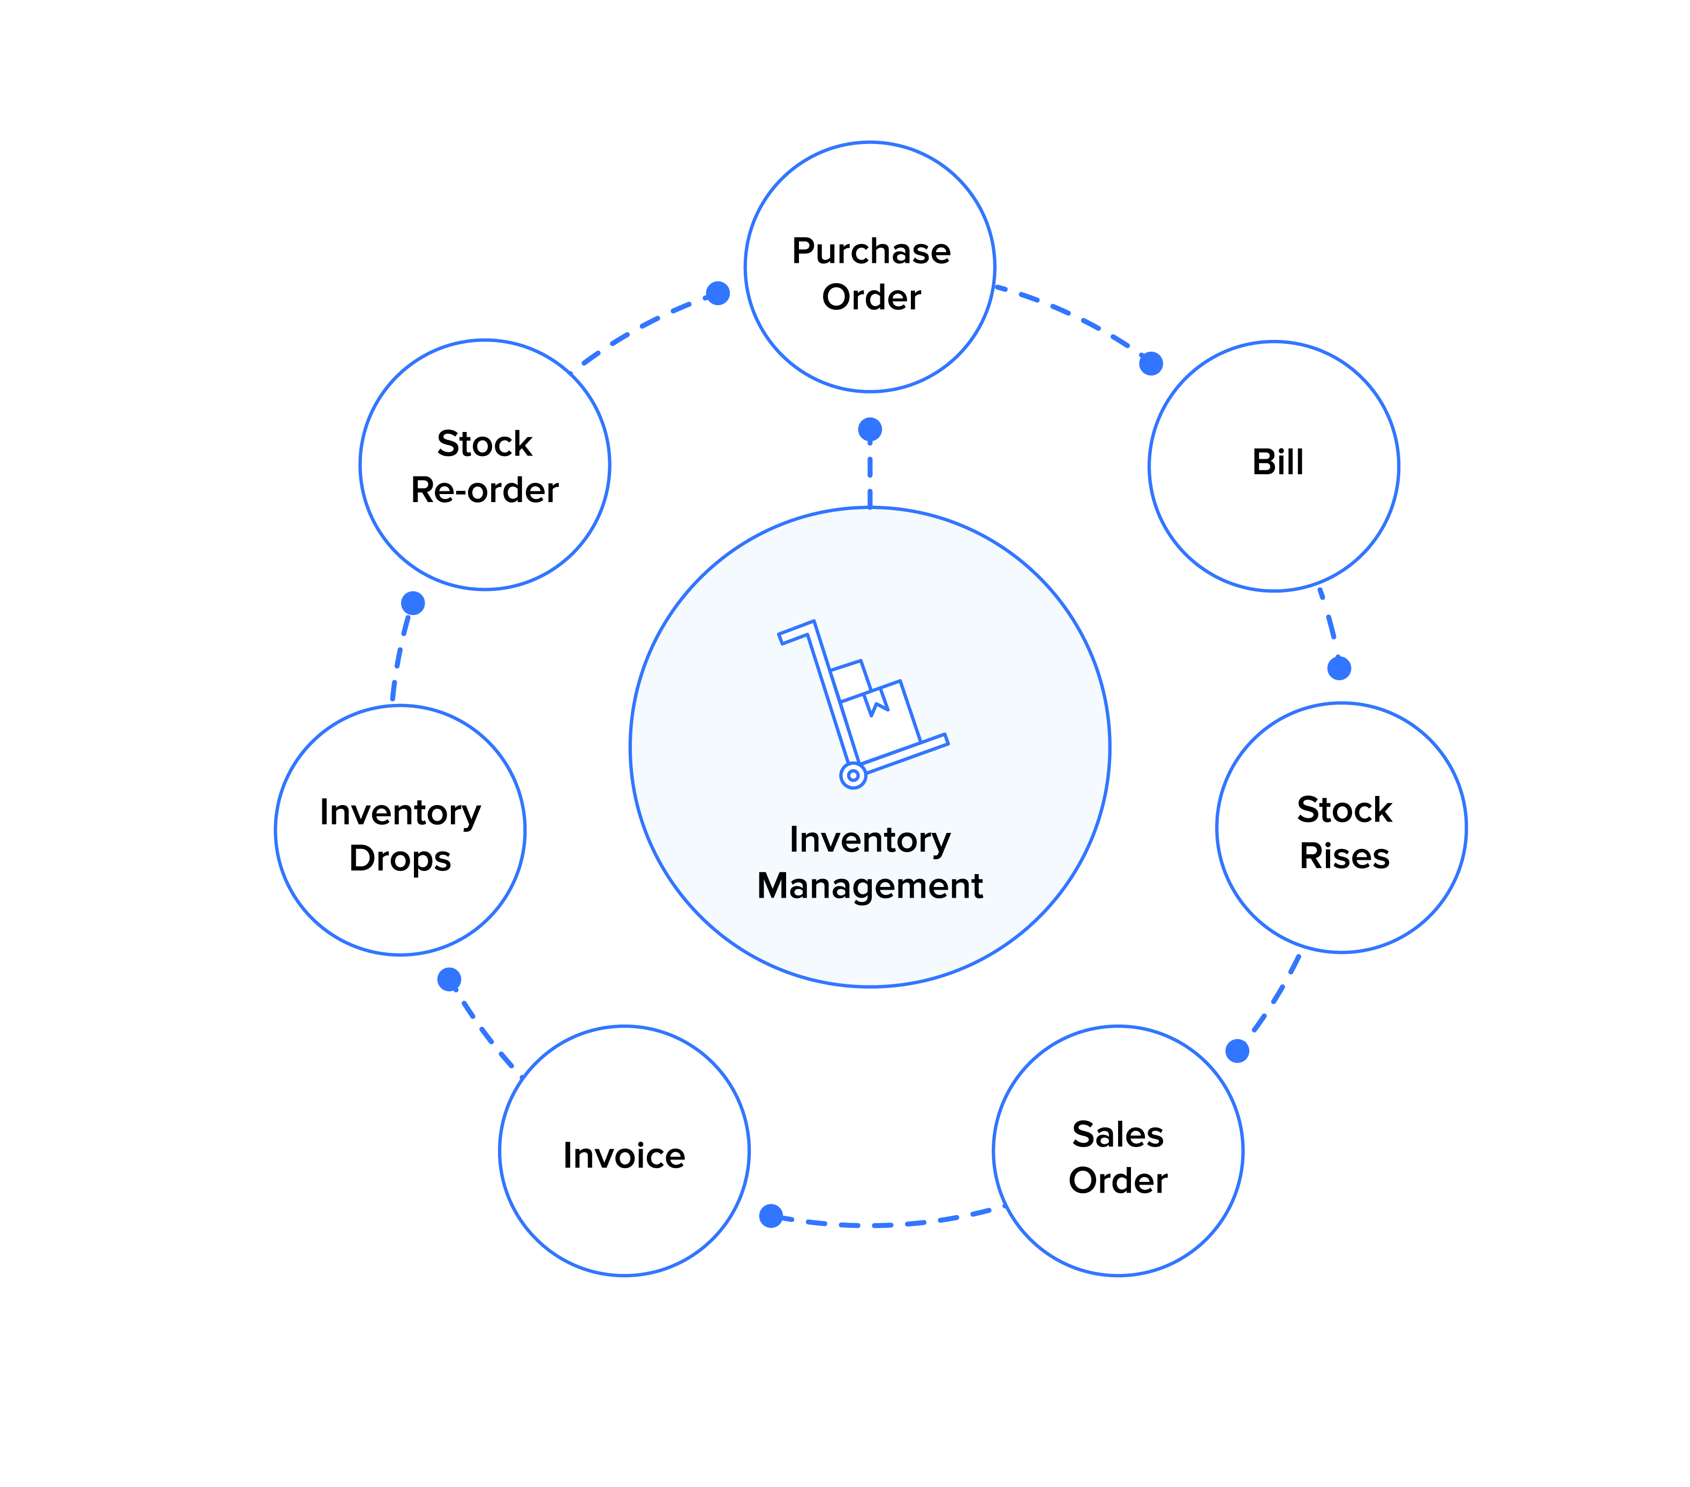
Introduction
• Summary of Background:
o Importance of inventory management in modern businesses.
o Need for efficient tracking of item transactions.
• Rationale:
o Necessity for a system that supports CRUD operations.
o Need for item listing, filtering, and transaction history features.
https://www.zoho.com/inventory/what-is-inventory-management/inventory-management-1x.png

Slide 4

Problem Definition
o Development of an inventory management system to track item transactions (adding, selling, inserting items).
o System supports CRUD operations and provides functionalities like item listing, filtering, and viewing transaction history.
https://www.google.com/imgres?q=crud%20operations&imgurl=https%3A%2F%2Fwww.atatus.com%2Fglossary%2Fcontent%2Fimages%2Fsize%2Fw960%2F2021%2F07%2FCRUD.jpeg&imgrefurl=https%3A%2F%2Fwww.atatus.com%2Fglossary%2Fcrud%2F&docid=iFxreTg1jItWmM&tbnid=6DJZ5LTimguePM&vet=12ahUKEwjt8o3lhtWHAxUepokEHbf-A4kQM3oECBwQAA..i&w=960&h=480&hcb=2&ved=2ahUKEwjt8o3lhtWHAxUepokEHbf-A4kQM3oECBwQAA

Slide 5
Design Requirements
Functions:
o Add Items
o View Items
o Edit Items
o Delete Items
o Filter Items
o Sell Items
Objectives:
o User-Friendly
o Scalable
o Reliable
o Maintainable
o Efficient
Constraints:
o Economic Factors
o Reliability
o Sustainability and Environmental Factors
o Ethics

Slide 6
Solutions1
Description
Frontend: Angular for user interface.
Backend: Spring Boot for server-side logic and data persistence (JPA).
Core functionality: Add items with basic details (ID, name, cost, price, quantity).
Limitations
No transaction tracking: Cannot record sales, purchases, or returns.
No item history: Cannot view changes in item data over time.
Basic filtering: Only filter by ID or name.
Limited functionality: Not a comprehensive inventory management solution.

Slide 7
Solutions 2
Description
Builds on Solution 1
Basic transactions: Selling and inserting items.
Angular interface: For user interaction and form handling.
Spring Boot backend: Handles transaction logic, inventory updates, and REST APIs.
Item filtering: Search by ID or name using Angular and Spring Boot.
Features
Selling: Set or custom prices, inventory updates.
Inserting: Record returns or add missing stock.
Limitations
No item history: Cannot track detailed transaction history.
Limited features: Lacks advanced functionalities like purchase orders and low-stock alerts.

Slide 8
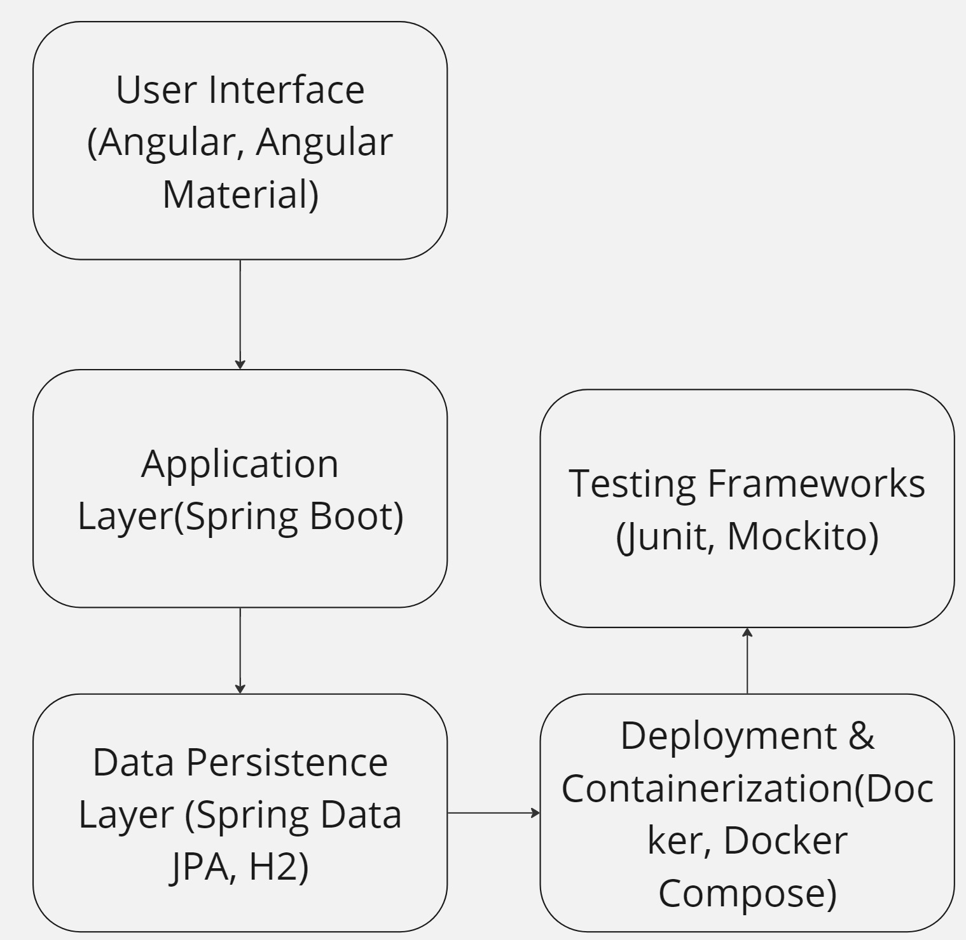
Final Solution
Description:
Comprehensive features with Angular, Spring Boot, detailed transaction history, advanced filtering, and Docker deployment.

Slide 9
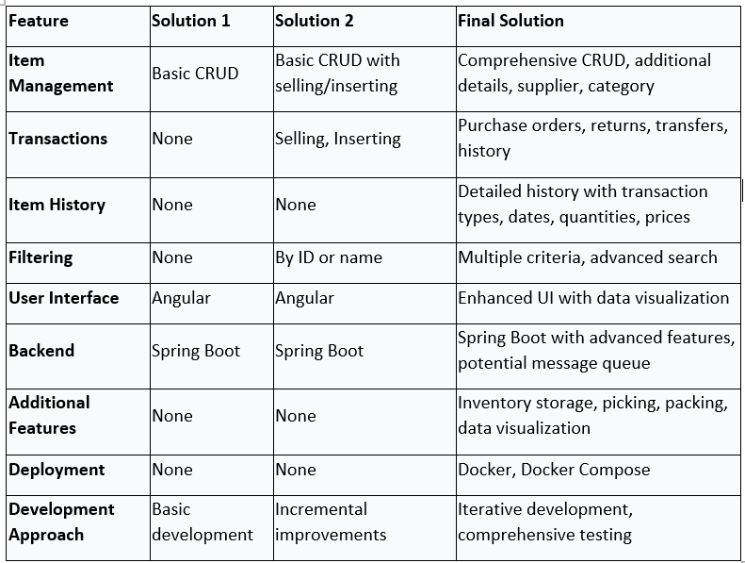

Slide 10
Testing and Demonstration
• Test Requirements:
o Boundary Value Testing
This technique focuses on testing values at the edges or boundaries of input conditions.
o Equivalence Class Testing
This technique aims to identify groups of input values that are likely to produce the same output.
o Decision Table Testing
This technique is used to test complex logical conditions and their corresponding actions.

Slide 11
Testing and Demonstration
• Test Requirements:
o State Transition Testing
This technique is used to test systems that have different states and transitions between those states.
o Use Case Testing
This technique focuses on testing the system's functionality based on user interactions and goals.

Slide 12
Testing and Demonstration
• Test Cases:
o Examples of test cases for ItemActionServiceImpl.java, ItemSummaryServiceImpl.java, and ItemServiceImpl.java

Slide 13
Testing and Demonstration
• Testing Results:
Demo of Junit test cases.

Slide 14
Testing and Demonstration
Project Demo

Slide 15
Project Management
Describe a Gantt chart representing the progress of your work.
Solution | Task/Phase | Start Date | End Date | Duration
Solution 1 | Requirement Gathering | May 15, 2024 | May 19, 2024 | 5 days
Solution 1 | Design | May 20, 2024 | May 24, 2024 | 5 days
Solution 1 | Development | May 25, 2024 | June 8, 2024 | 15 days
Solution 1 | Testing | June 9, 2024 | June 13, 2024 | 5 days
Solution 1 | Review & Refine | June 14, 2024 | June 18, 2024 | 5 days
Solution 2 | Requirement Gathering | June 19, 2024 | June 23, 2024 | 5 days
Solution 2 | Design | June 24, 2024 | June 28, 2024 | 5 days
Solution 2 | Development | June 29, 2024 | July 12, 2024 | 14 days
Solution 2 | Testing | July 13, 2024 | July 17, 2024 | 5 days
Solution 2 | Review & Refine | July 18, 2024 | July 20, 2024 | 3 days
Final Solution | Requirement Gathering | May 15, 2024 | May 19, 2024 | 5 days
Final Solution | Design | May 20, 2024 | May 24, 2024 | 5 days
Final Solution | Development | May 25, 2024 | June 22, 2024 | 29 days
Final Solution | Testing | June 23, 2024 | June 29, 2024 | 7 days
Final Solution | Review & Refine | June 30, 2024 | July 20, 2024 | 21 days

Slide 16
Conclusion and Future Work
• Conclusion:
o Achievements of the project in enhancing operational efficiency.
o Successful integration of Angular and Spring Boot for a seamless user experience.
• Future Work:
o Potential enhancements.
o Plans for further development and scalability.
o Will improve current functionality and improve user experience.

